Slide 1
S.O.L.I.D.
The benefits and potential of using SOLID principles
S
Single Responsibility
O
Open/Closed
L
Liskov substitution
I
Interface Segregation
D
Dependency Inversion
SoftUni Team
Technical Trainers
Software University
http://softuni.bg

Slide 2

Table of Contents
Single Responsibility
A Class Should Have Only One Reason to Change
Open / Closed
Liskov Substitution
Interface Segregation
Dependency Inversion

Slide 3
Have a Question?
sli.do
#java-advanced

Slide 4
SOLID
SOLID Principles

Slide 5
S.O.L.I.D.
S – Single responsibility principle – class should only have one responsibility
O – Open–closed principle – open for extension, but closed for modification
L – Liskov substitution principle – objects should be replaceable with instances of their subtypes without altering the correctness of that program

Slide 6

S.O.L.I.D.
I – Interface segregation principle – many specific interfaces are better than one general interface
D – Dependency inversion principle – one should depend upon abstractions, not concretions

Slide 7
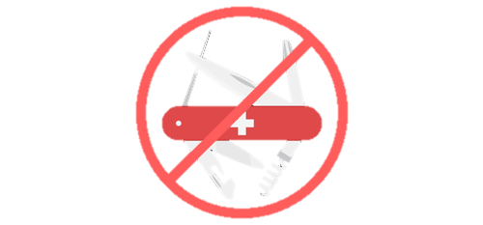
Single Responsibility
A Class Should Have Only One Reason to Change

Slide 8
Single Responsibility Principle
A class should have only one responsibility
Reduces dependency complexity
Each additional responsibility is an axis to change the class
public class HeroSettings {
public static void changeName(Hero hero) {
// Grant option to change
}
}

Slide 9
Single Responsibility Principle
Still classes can have multiple methods
Each method should have single functionality part of the class responsibility
public class HeroSettings {
public static void changeName(Hero hero) {
// Grant option to change name
}
public static void selectRole(Hero hero) {
// Grant option to select role
}
}

Slide 10


Open / Closed

Slide 11
What is Open/Closed?
"Software entities (classes, modules, functions, etc.) should be open for extension, but closed for modification."

Slide 12

Extensibility
Implementation takes future growth into consideration
Extensible system is one whose internal structure and data flow are minimally or not affected by new or modified functionality

Slide 13

Reusability
Software reusability more specifically refers to design features of a software element that enhance its suitability for reuse
Modularity
Low coupling
High cohesion
Coupling and Cohesion

Slide 14
Open/Closed Principle (OCP)
Design and writing of the code should be done in a way that new functionality should be added with minimum changes in the existing code
Changes to source code are not required

Slide 15

OCP – Violations
Cascading changes through modules
Each change requires re-testing
Logic depends on conditional statements

Slide 16

OCP – Solutions
Inheritance / Abstraction
Inheritance / Template Method pattern
Composition / Strategy patterns

Slide 17

Liskov Substitution

Slide 18
What is Liskov Substitution?
"Derived types must be completely substitutable for their base types"
Reference to the base class can be replaced with a derived class without affecting the functionality of the program module
Derived classes just extend without replacing the functionality of old classes

Slide 19
LSP Relationship
OOP Inheritance
Plus LSP
Student IS-A Person
Student IS-SUBSTITUTED-FOR Person

Slide 20
OCP vs LSP
"Liskov Substitution Principle is just an extension of the Open Close Principle and it means that we must make sure that new derived classes are extending the base classes without changing their behavior."

Slide 21
LSP – Violations
Type Checking
Overridden methods say "I am not implemented"
Base class depends on its subtypes

Slide 22
LSP – Solutions
"Tell, Don't Ask"
Refactoring in the base class

Slide 23

Interface Segregation
Clients Require Cohesive Interfaces

Slide 24
ISP – Interface Segregation Principle
"Clients should not be forced to depend on methods they do not use."
Segregate interfaces
Prefer small, cohesive interfaces
Divide "fat" interfaces into "role" interfaces

Slide 25
Fat Interfaces
Classes whose interfaces are not cohesive have "fat" interfaces
public interface Worker {
void work();
void sleep();
}
Class Employee is OK
public class Robot implements Worker {
public void work() {}
public void sleep() {
throw new UnsupportedOperationException();
}
}

Slide 26
"Fat" Interfaces
Having "fat" interfaces:
Classes have methods they do not use
Increased coupling
Reduced flexibility
Reduced maintainability

Slide 27
How to ISP?
Solutions to broken ISP
Small interfaces
Cohesive interfaces
Let the client define interfaces – "role" interfaces

Slide 28
Cohesive Interfaces
Small and Cohesive "Role" Interfaces
public interface Worker {
void work();
}
public interface Sleeper {
void sleep();
}
public class Robot implements Worker {
void work() {
// Do some work…
}
}

Slide 29
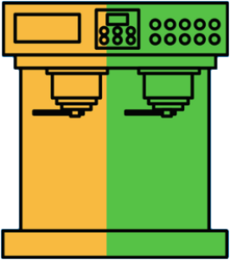
Dependency Inversion
Flip Dependencies

Slide 30
Dependency Inversion Principle (DIP)
"Dependency Inversion Principle says that high-level modules should not depend on low-level modules. Both should depend on abstractions."
"Abstractions should not depend on details. Details should depend on abstractions."
Goal: decoupling between modules through abstractions

Slide 31
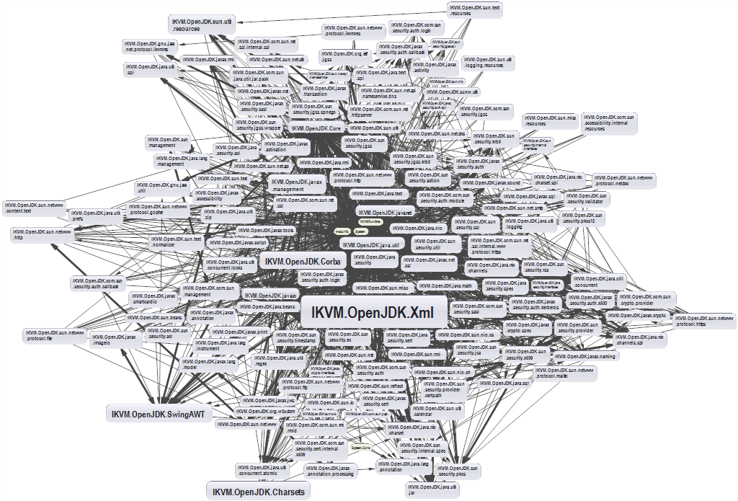
Dependencies and Coupling (1)
What happens when modules depend directly on other modules

Slide 32
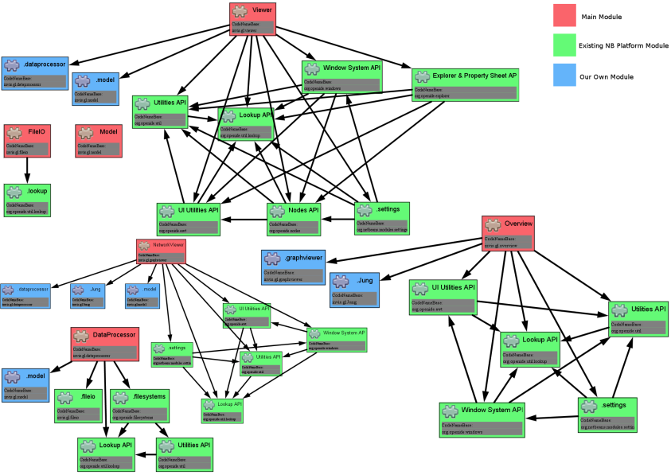
Dependencies and Coupling (2)
The goal is to depend on abstractions

Slide 33
The Problem
Button → Lamp Example – Robert Martin
Button depends on Lamp
High-level / Client
Lamp
turnOn()
turnOff()
Button
poll()
Low-level / Server

Slide 34
Dependency Inversion Solution
Find the abstraction independent of details
SwitchableDevice
<interface>
turnOn()
turnOff()
Button
poll()
uses
Client defines interfaces
implements
Lamp

Slide 35
Dependency Examples
A dependency is any external component / system:
Framework
Third party library
Database
File system
Email
Web service
System resource (e.g. clock)
Configuration
The new keyword
Static method
Global function
Random generator
System.in / System.out

Slide 36

How to DIP? (1)
Constructor injection - dependencies are passed through constructors
Pros
Classes self-documenting requirements
Works well without container
Always valid state
Cons
Many parameters
Some methods may not need everything

Slide 37
Constructor Injection – Example
public class Copy {
private Reader reader;
private Writer writer;
public Copy(Reader reader, Writer writer) {
this.reader = reader;
this.writer = writer;
}
public void copyAll() {}
}

Slide 38
How to DIP? (2)
Setter Injection - dependencies are passed through setters
Pros
Can be changed anytime
Very flexible
Cons
Possible invalid state of the object
Less intuitive

Slide 39
Setter Injection – Example
public class Copy {
private Reader reader;
private Writer writer;
public void setReader(Reader reader) {}
public void setWriter(Writer writer) {}
public void copyAll() {}
}

Slide 40
How to DIP? (3)
Parameter injection - dependencies are passed through method parameters
Pros
No change in rest of the class
Very flexible
Cons
Many parameters
Breaks the method signature
public class Copy {
public void copyAll(Reader reader, Writer writer) {}
}

Slide 41
Layering (1)
Traditional programming
High-level modules use low-level modules
UI Layer
UI Layer
Business Layer
Business Layer
Data Access Layer
Data Access Layer

Slide 42
Layering (2)
Dependency Inversion Layering
High and low-level modules depend on abstractions
Client defines interfaces
UI Layer
<BL Interface>
Business Layer
<DAL Interface>
Data Access Layer

Slide 43
Problem: Employee Info
You are given some classes
Refactor the code so that it conforms to DIP
Main
ConsoleFormatter
EmployeeInfoProvider
EmployeeDatabase

Slide 44
Solution: Employee Info
ConsoleClient
<Formatter>
<InfoProvider>
ConsoleFormatter
EmployeeInfoProvider
<Database>
EmployeeDatabase

Slide 45

Summary
…
…
…
SOLID principle make software more:
Understandable
Flexible
Maintainable

Slide 46
https://softuni.bg/modules/59/java-advanced

Slide 47






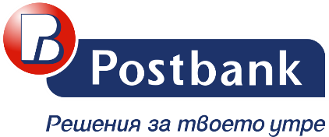



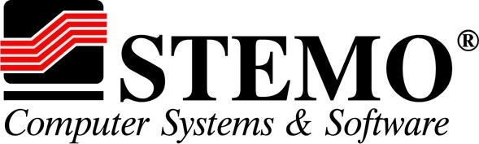

SoftUni Diamond Partners

Slide 48

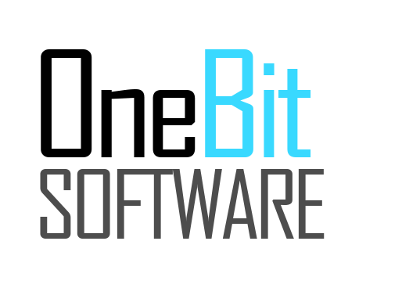


SoftUni Organizational Partners

Slide 49




Trainings @ Software University (SoftUni)
Software University – High-Quality Education and Employment Opportunities
softuni.bg
Software University Foundation
http://softuni.foundation/
Software University @ Facebook
facebook.com/SoftwareUniversity
Software University Forums
forum.softuni.bg

Slide 50

License
This course (slides, examples, demos, videos, homework, etc.) is licensed under the "Creative Commons Attribution-NonCommercial-ShareAlike 4.0 International" license

